Slide 1
DEFENSE ELECTRONIC WARFARE // DRDO DEPUTED
Tactical Army Counter-Drone (C-UAS) Platform
Real-time SDR multi-waveform jamming, PostGIS airspace telemetry, and PyQt5 mission command.

Slide 2
OPERATIONAL CHALLENGE
Asymmetric Airspace Threat Vectors
2.4 / 5.8
< 20ms
350
Dual-band GHz ISM control hopping.
Closed loop intercept to actuation.
Hops per second tracking rate.

Slide 3
TACTICAL ARCHITECTURE
Core Engineering Pillars
SDR Hardware Layer
Reactive Jamming
Python Standardization
HackRF and ANTSDR integration.
Multi-synchronous pulse waveforms.
PEP standards across PyQt5 UI.

Slide 4

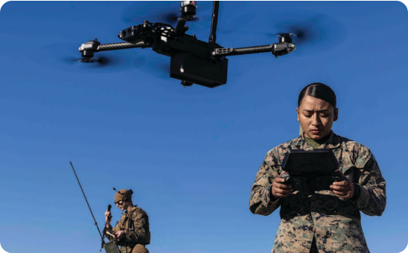
SPATIAL RADAR TRACKING
PostGIS & QGIS Offline Airspace Mapping
Spatial Geofencing: Automated boundary threat assessment.
QGIS Tactical Layers: 1:25,000 elevation contours overlay.
GNSS Spoofing: Tactical coordinate override actuation.

Slide 5
PERFORMANCE VALIDATION
Operational Field Benchmark
99.4%
Link suppression success across tested commercial UAV protocols
Zero Interlock Drift: 100+ simulated trials
Thermal Ceiling: 48°C field validated

Slide 6
FIELD DEPLOYED DEFENSE ARCHITECTURE
Mission-Ready Counter-UAS Electronics
Engineered with strict Python standards, robust spatial persistence, and sub-20ms SDR responsiveness.

Slide 7

Image Sources
https://media.defense.gov/2024/Jul/15/2003503603/1920/1080/0/240715-M-HL692-0015.JPG
Source: ndupress.ndu.edu

